Slide 1
Summary on Pytorch OpenMP
Haibin & Wenyi
3.24 – 5.12

Slide 2
Problem statement

Slide 3
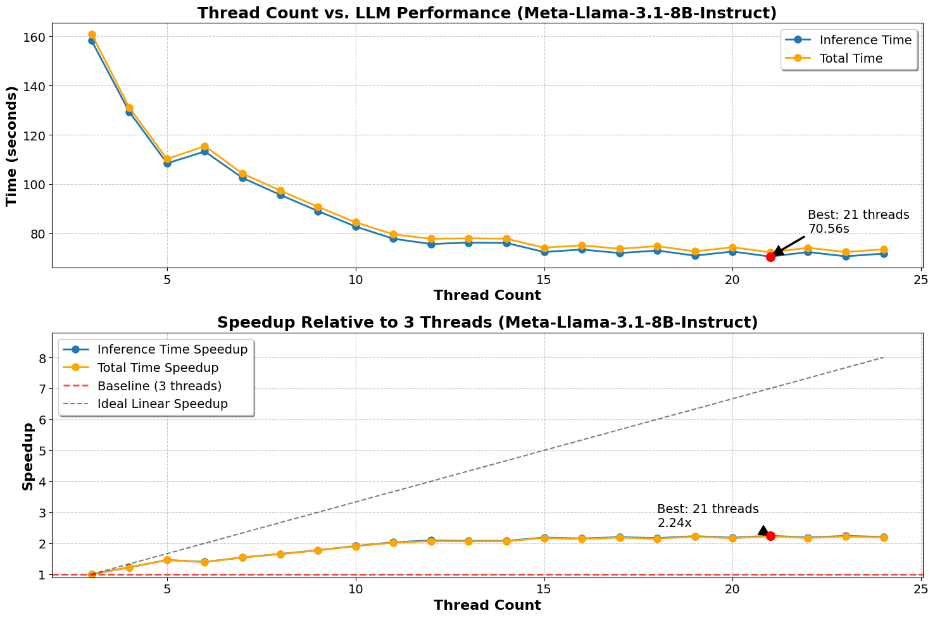
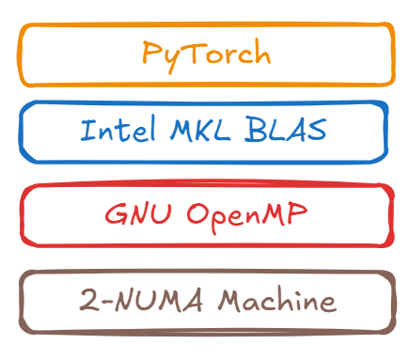
LLM gets bad speedup with GNU OpenMP
Llama-3.1-8B
256 token
GNU OpenMP
Run Baseline Analysis https://www.notion.so/Pytorch-OpenMP-1c25ab55420e80449eb4f7d4619fb85e?pvs=4

Slide 4
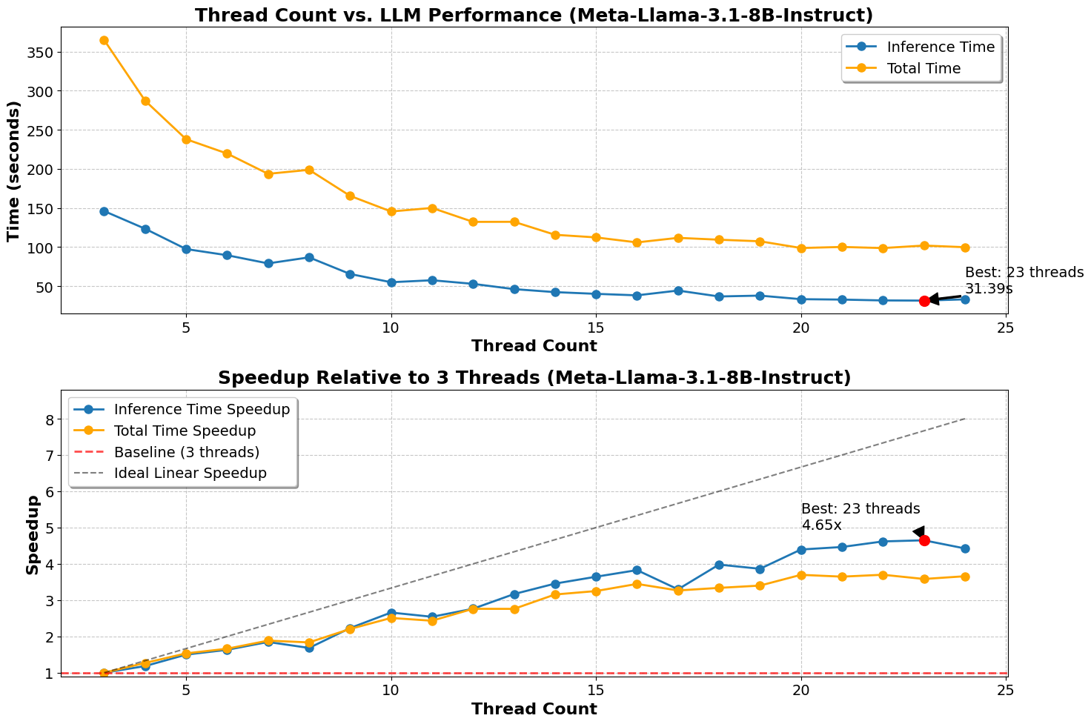
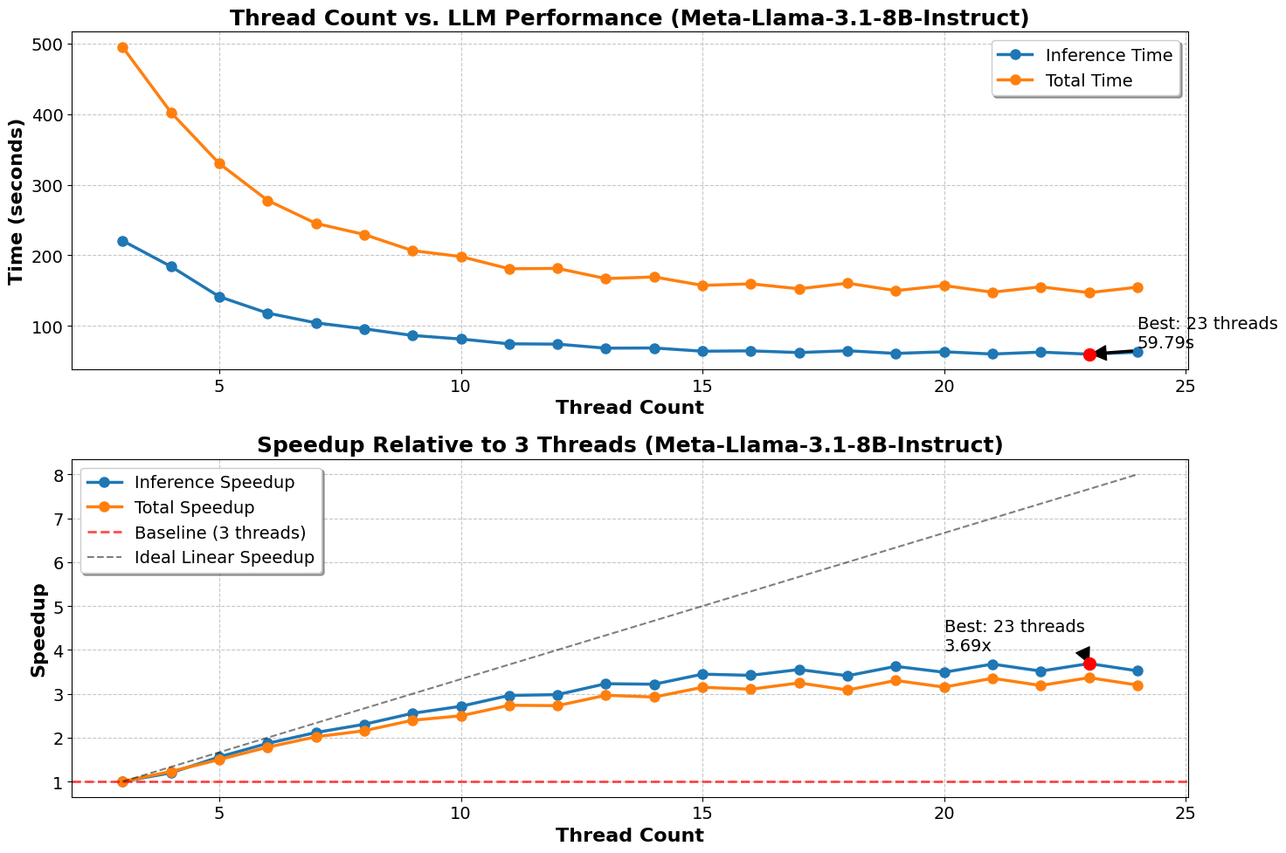
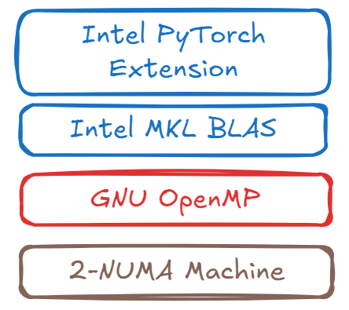
Intel Extension helps better, but still doesn’t scale up
Llama-3.1-8B
256 token
GNU OpenMP
Intel Extension has 24+ parameters, hard to find the same with Llama baseline. But we can see the trend
Intel Extension Analysis https://www.notion.so/Intel-Extension-1c45ab55420e8092b205f245e3a00ccf?pvs=4

Slide 5
Why?
We still have space to boost LLM inference. From about 10X to 15X-20X ?

Slide 6
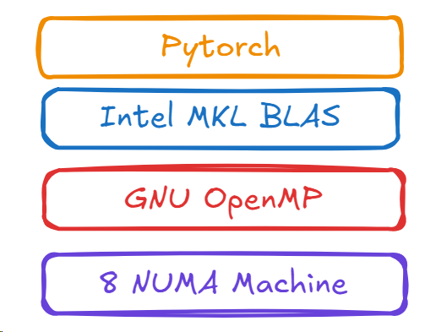



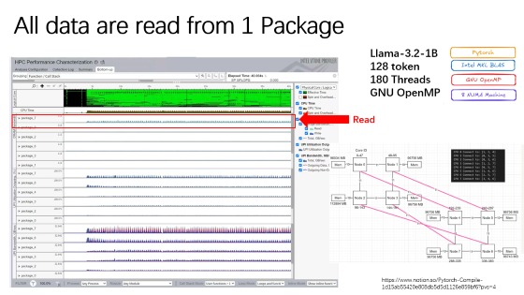
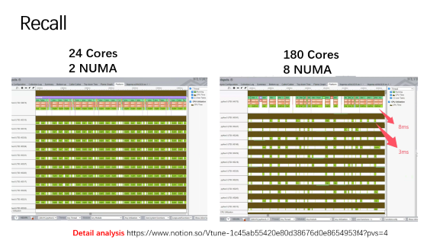
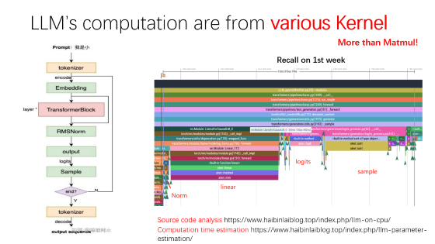
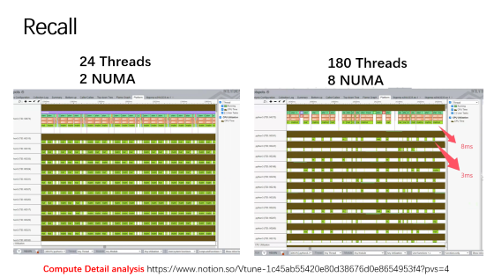
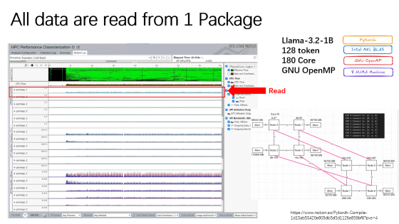
3 bottlenecks for 8-NUMA LLM Inference
1. Unfused operators, limited parallelism
2. NUMA cross-node access bottleneck
3. Small matrix multiplications hinder multi-core parallelism

Slide 7
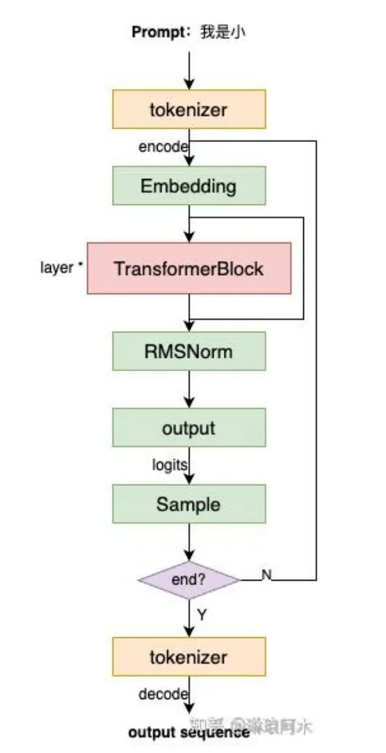
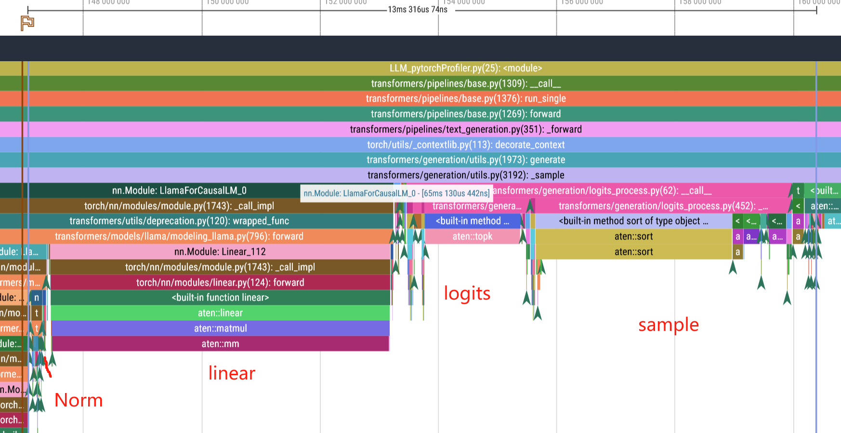
LLM’s computation are from various Kernel
More than Matmul!
Recall on 1st week
Source code analysis https://www.haibinlaiblog.top/index.php/llm-on-cpu/
Computation time estimation https://www.haibinlaiblog.top/index.php/llm-parameter-estimation/

Slide 8
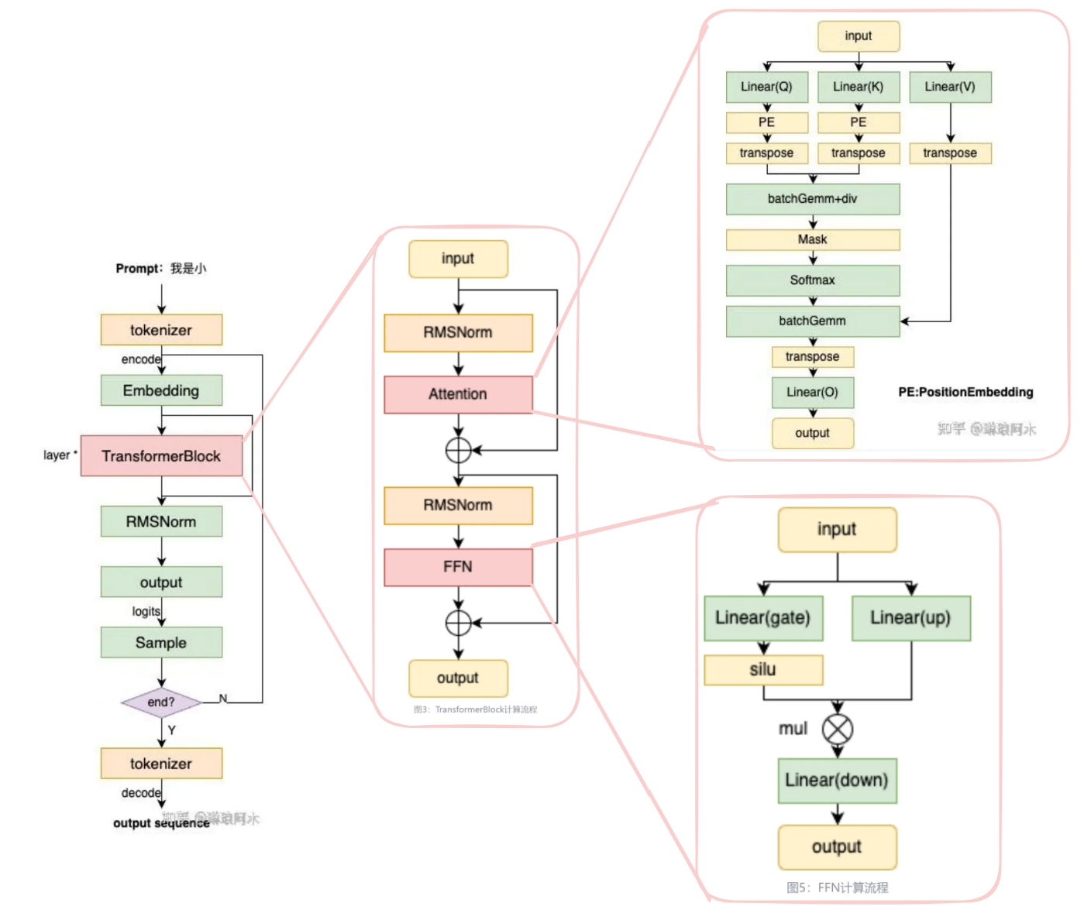
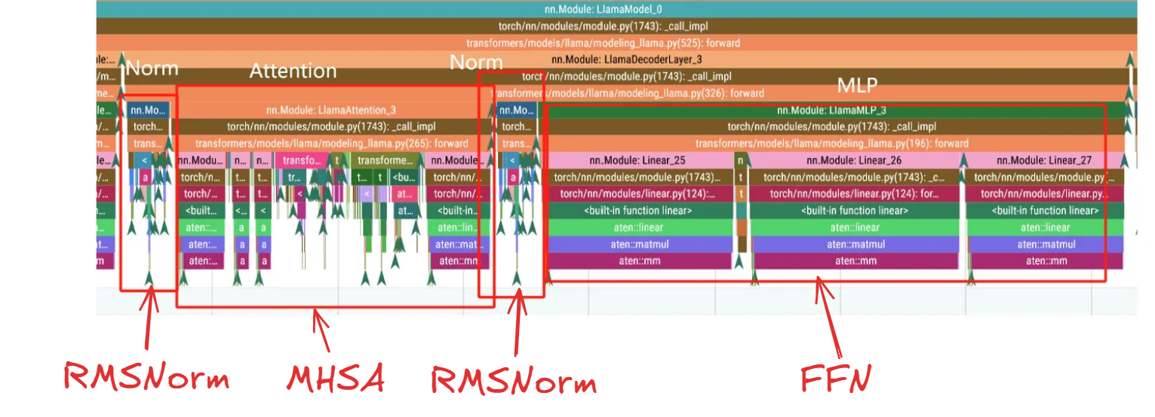
Main cost are from various Kernel in Transformer block
More than Matmul!
Recall on 1st week
Source code analysis https://www.haibinlaiblog.top/index.php/llm-on-cpu/
Llama Analysis https://www.notion.so/Pytorch-OpenMP-1c25ab55420e80449eb4f7d4619fb85e?pvs=4
Computation time estimation https://www.haibinlaiblog.top/index.php/llm-parameter-estimation/

Slide 9
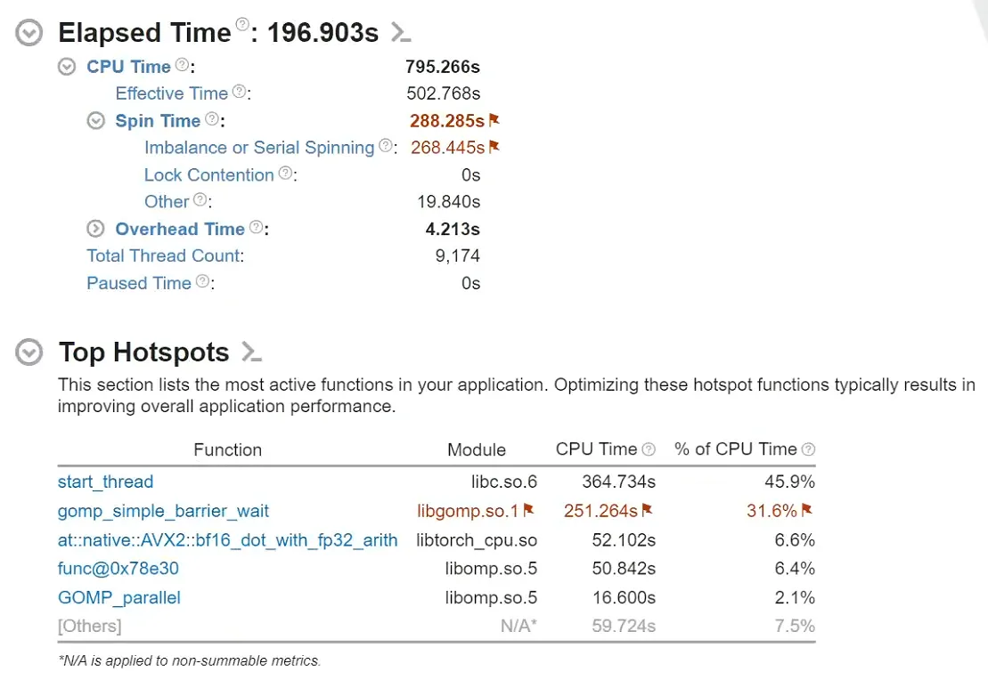
OpenMP is waiting
Llama-3.2-1B
128 token
24 Threads
Recompile GCC
GNU OpenMP
Recompile GCC https://www.notion.so/Pytorch-Compile-1d15ab55420e808db5d5d1126e859bf6?pvs=4

Slide 10
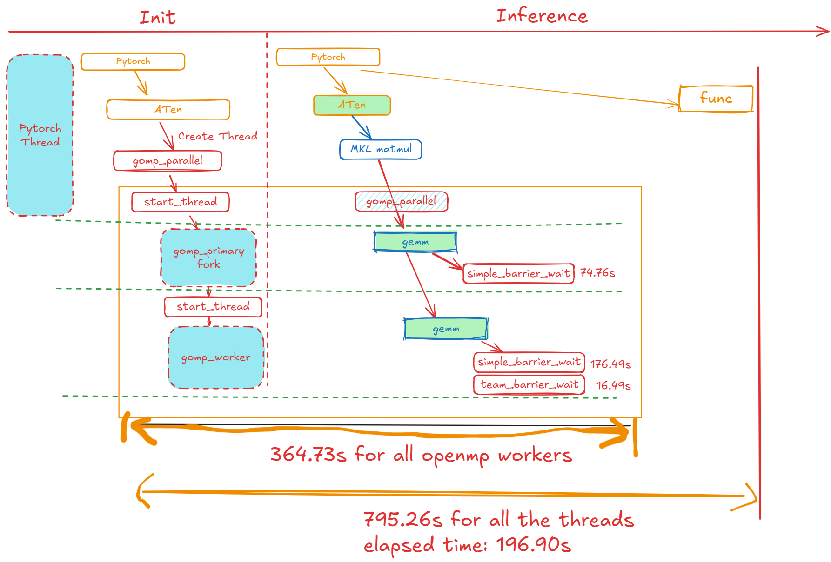
A better version

Slide 11
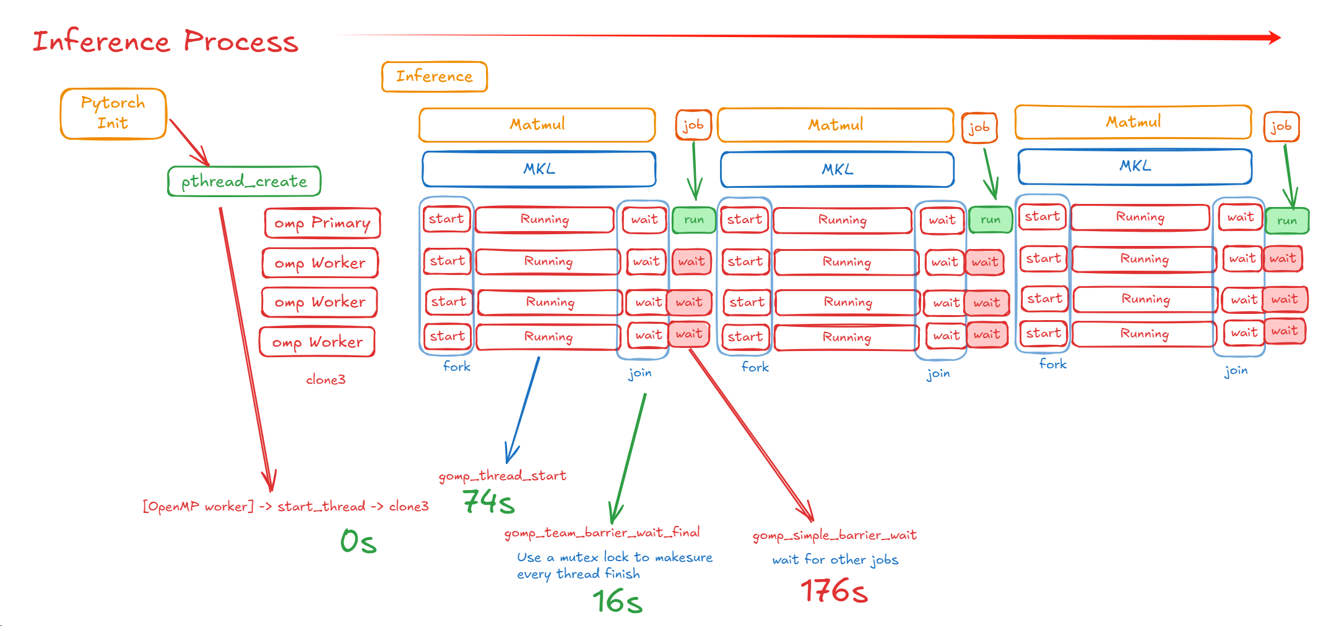
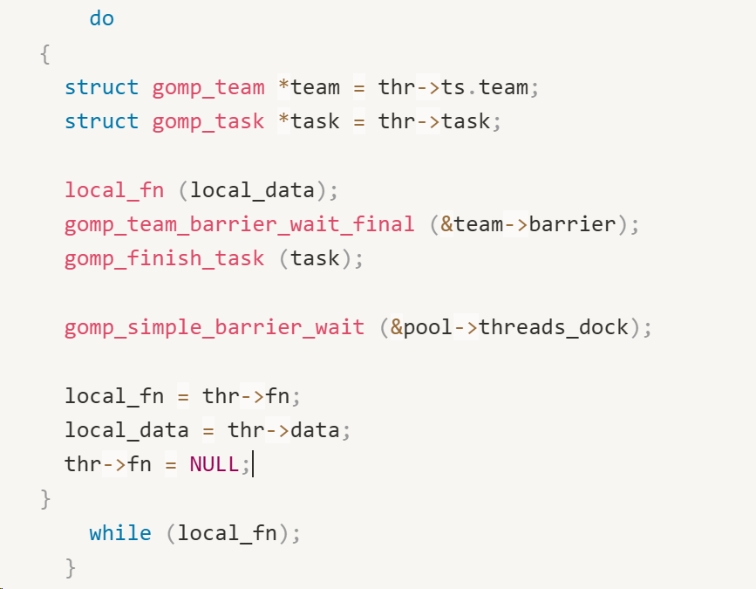
OpenMP is waiting for new job!
GNU Software Stack Analysis https://www.notion.so/GNU-GCC-OpenMP-Analysis-1f15ab55420e802bb833f852ebd39303?pvs=4

Slide 12
Conclusion
We need Operator fusion in intel-pytorch-extension

Slide 13
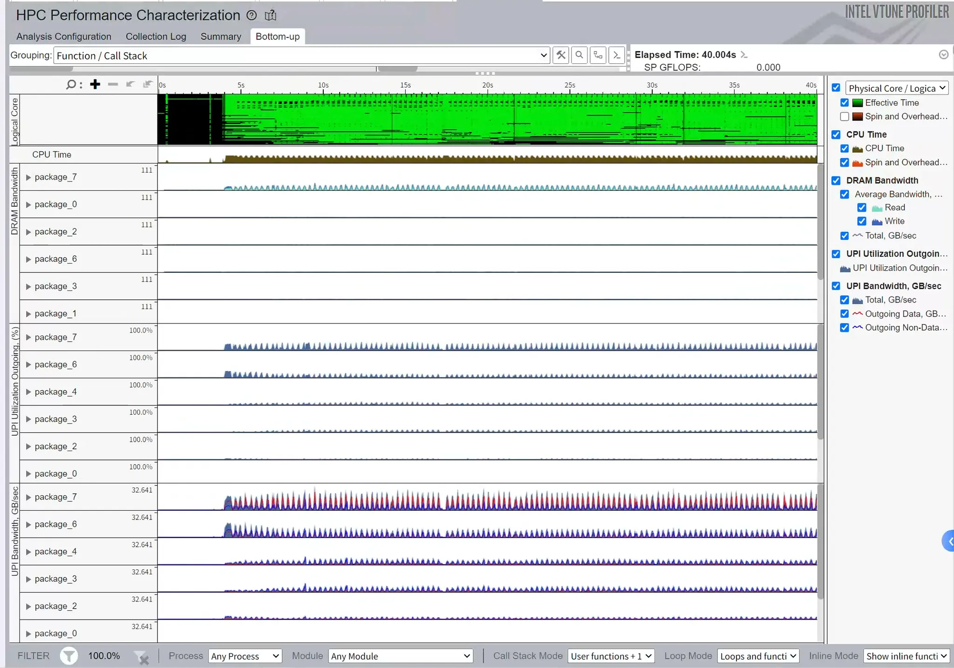
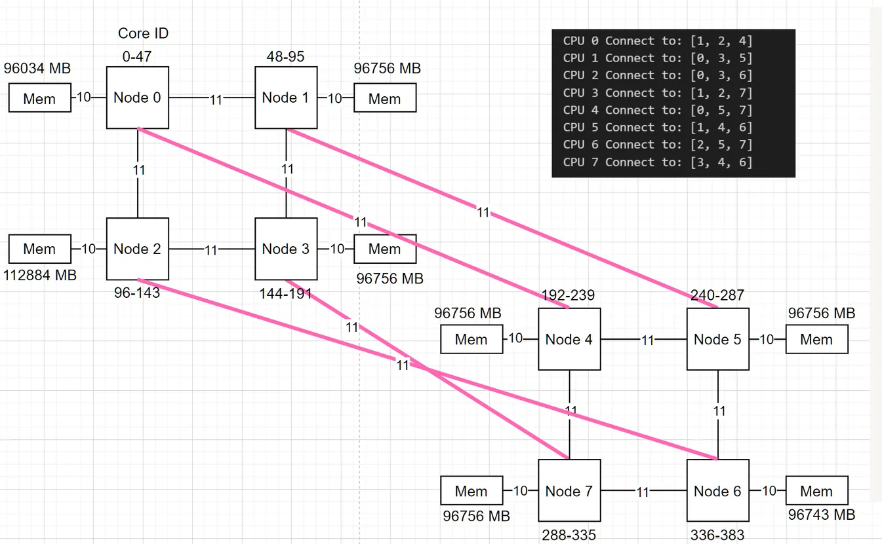
All data are read from 1 Package
Llama-3.2-1B
128 token
180 Threads
GNU OpenMP
Read
https://www.notion.so/Pytorch-Compile-1d15ab55420e808db5d5d1126e859bf6?pvs=4

Slide 14
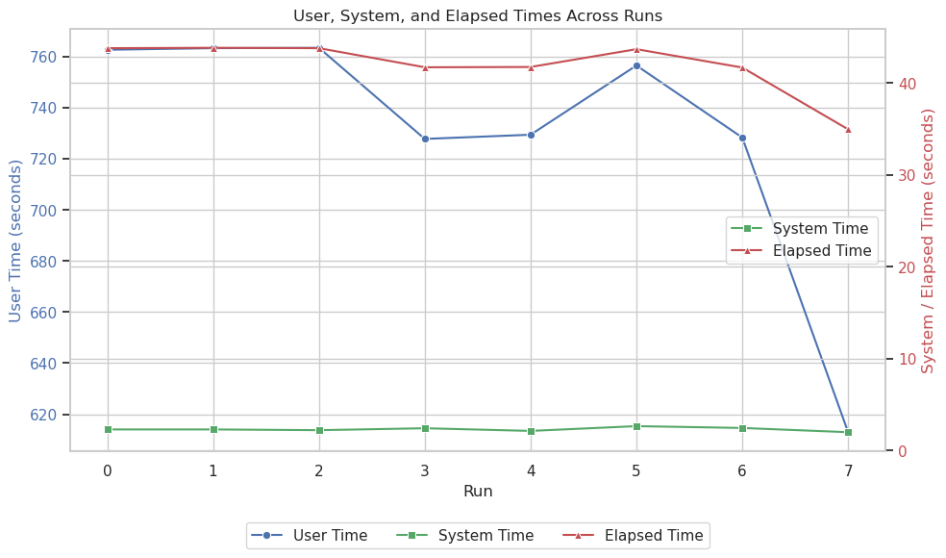
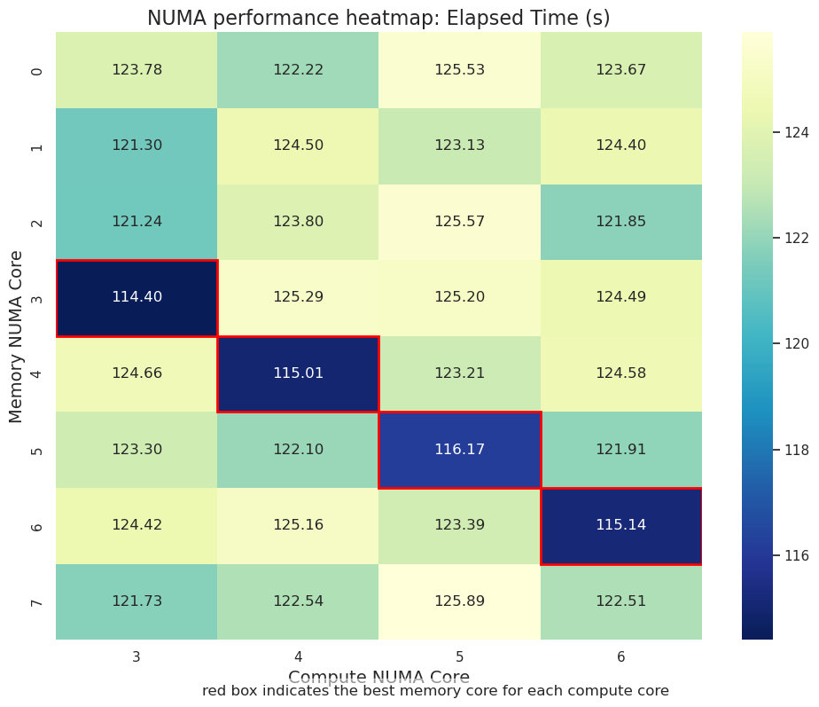
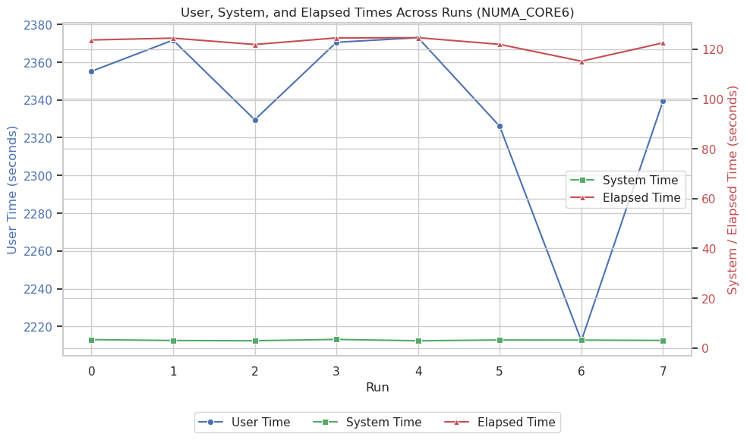
LLM store the model in package 7. Can’t Reduce all the memory issue.

Slide 15
Conclusion
If we change the inference into task based, it maybe better for scheduling
Mem Detail Analysis https://www.notion.so/Pytorch-Compile-1d15ab55420e808db5d5d1126e859bf6?pvs=4

Slide 16
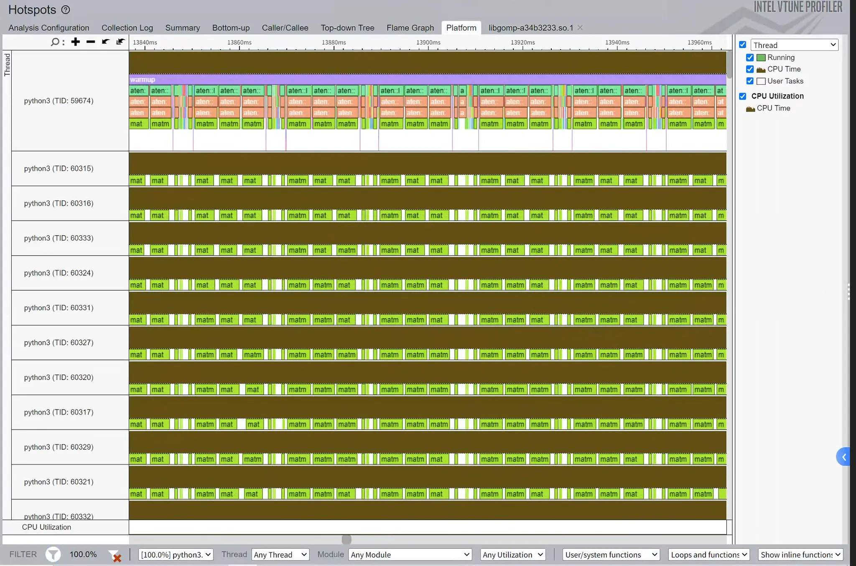
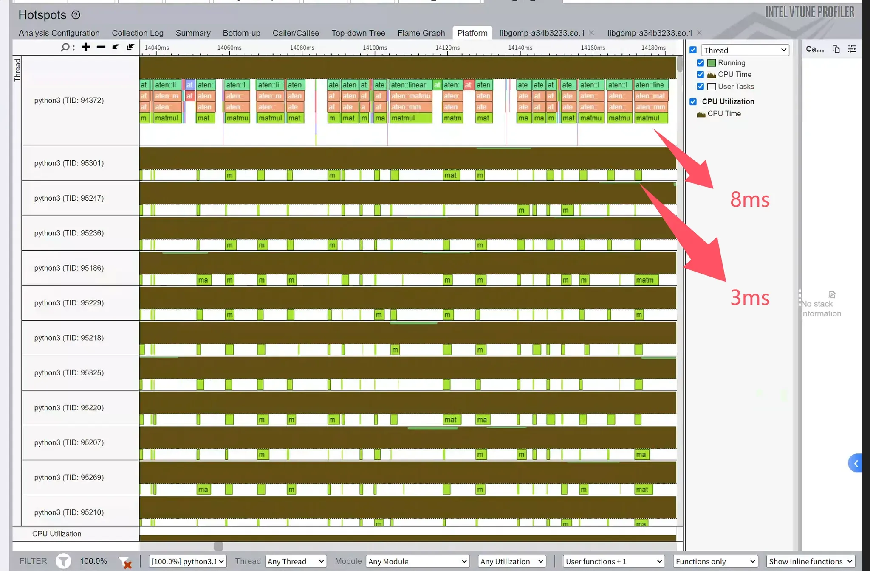
Recall
24 Threads
2 NUMA
180 Threads
8 NUMA
Compute Detail analysis https://www.notion.so/Vtune-1c45ab55420e80d38676d0e8654953f4?pvs=4
https://www.notion.so/Pytorch-Compile-1d15ab55420e808db5d5d1126e859bf6?pvs=4

Slide 17
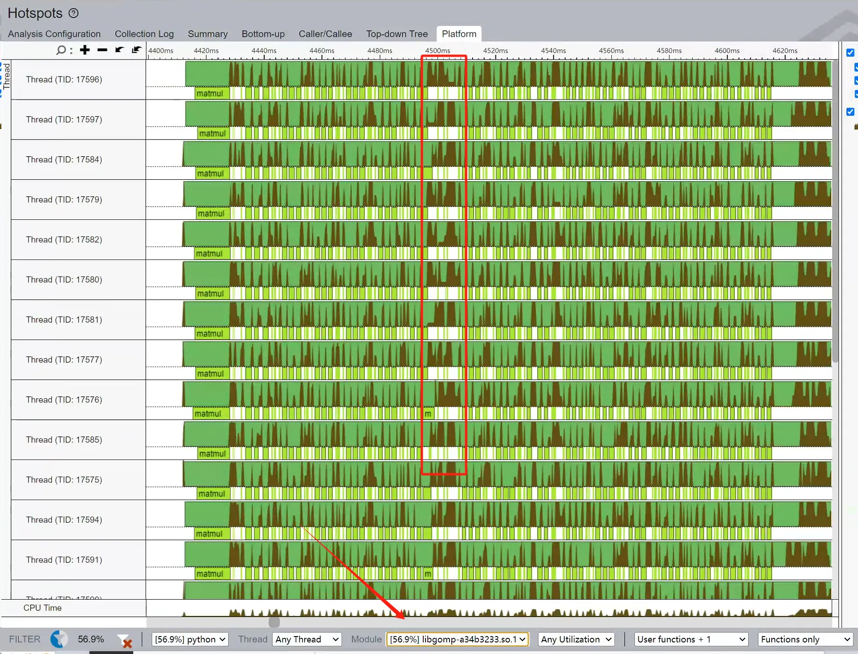
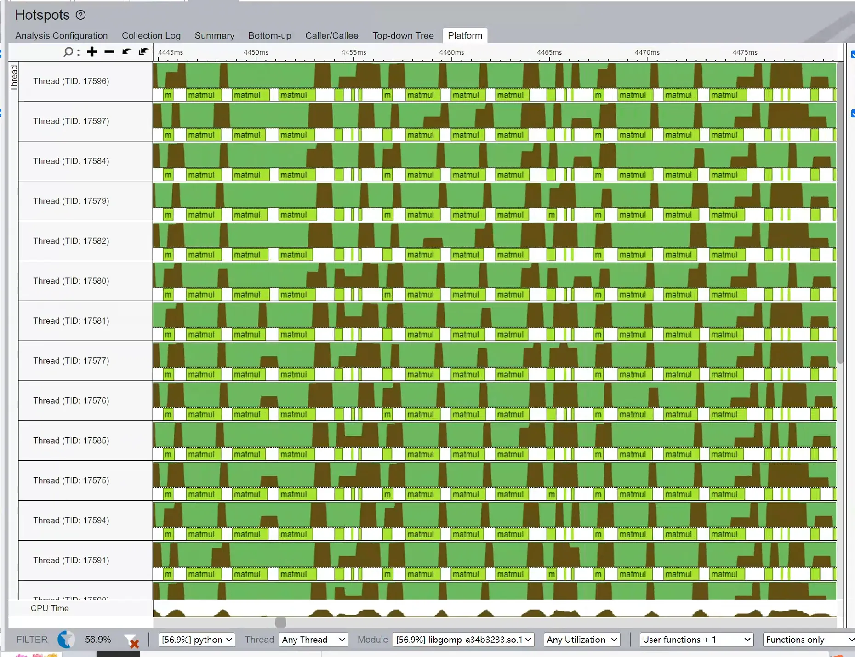
Some Imbalance problem
ftrace, ptrace analysis https://www.notion.so/Pytorch-Compile-1d15ab55420e808db5d5d1126e859bf6?pvs=4

Slide 18
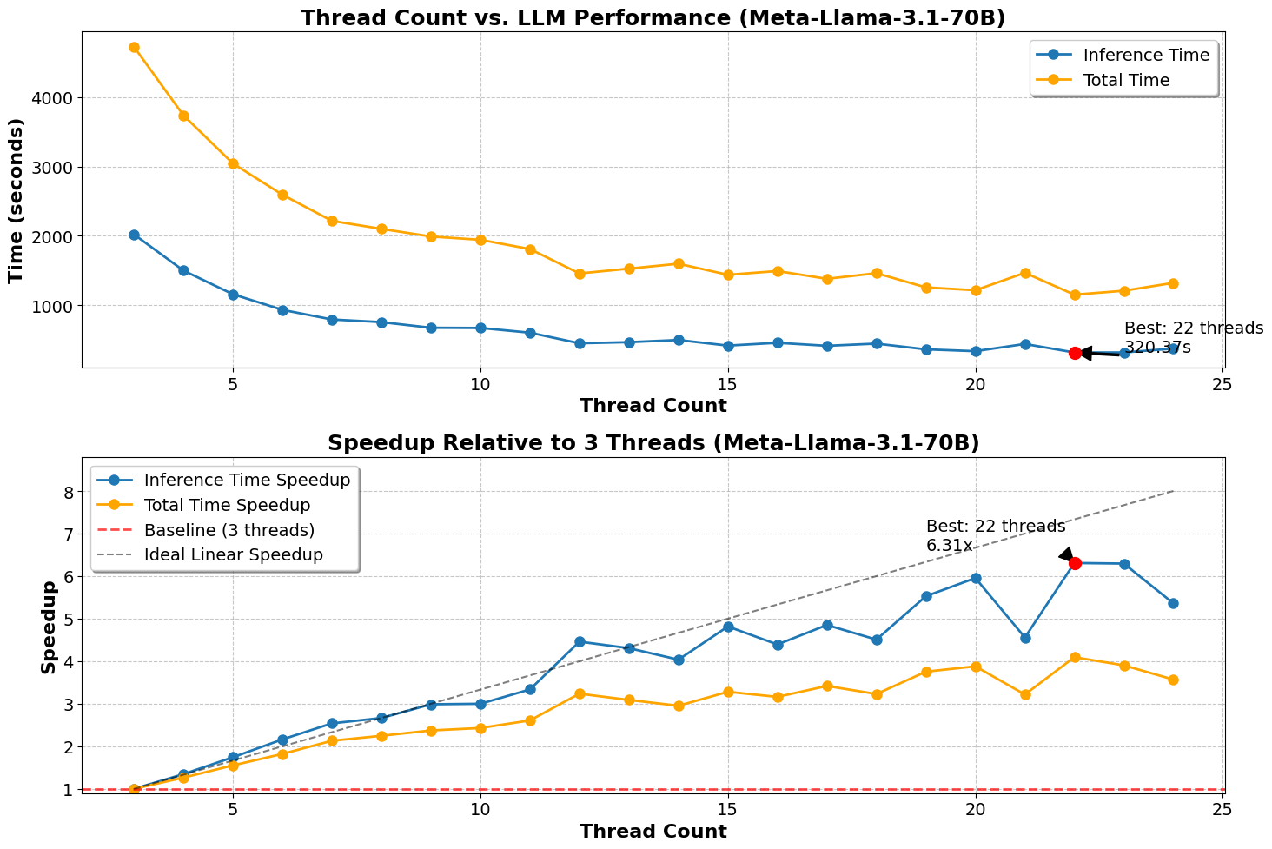
It’s hard to spend 180 Core to compute a 3ms Matmul
Can we make the matmul larger: bigger model
Meta Llama 70B
256 token
Things are getting better, but it takes too much time for inference

Slide 19
Conclusion
We can’t scale up for 24 threads, let alone 180 threads
Using bigger model for inference cost too much time

Slide 20
Summary

Slide 21
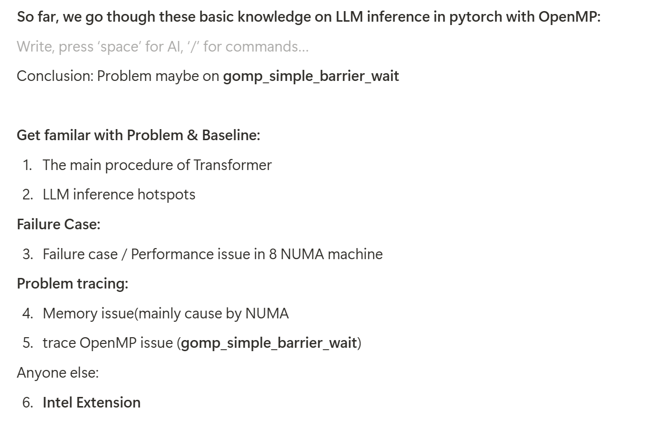
Summary of what we have done

Slide 22
3 bottlenecks for 8-NUMA
1. Operators -> intel extension operator fusion
2. Memory issue from NUMA -> X-Queue load balance may work
3. Many Cores for 3ms Matmul -> ? Hard to scale or change bigger Llama model

Slide 23
For memory optimization
1. how much space we will have?
NUMA7 min runtime 34s; NUMA6 min runtime 115s
2. Challenge:
Task based runtime may be worst than direct OpenMP in Aten (Engineering Problem)
3. Rest of Workflow (If continue) :
Change Pytorch into Task-based / Change Intel Extension Pytorch into Task-based
Change GCC into X-Queue-GCC

Slide 24
But
If a matmul takes 3ms for 4 threads, it’s hard to take 0.3ms for 40 threads
We can boost LLM inference from 4 token/s -> 8 token/s, but we may never reach 40 token/s.
An idea that make inference better may be: a bigger model like 70B
But if we can’t meet the requirement, LLM on CPU may be wrong.

Slide 25
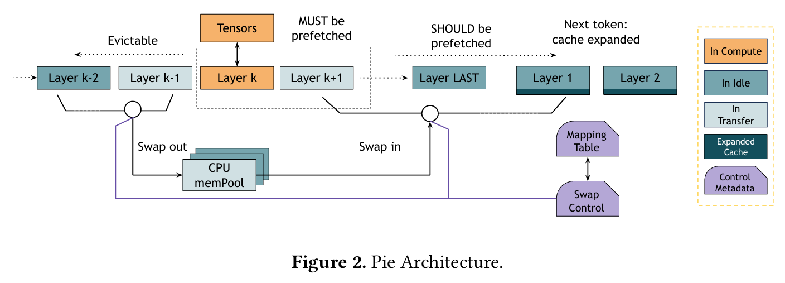
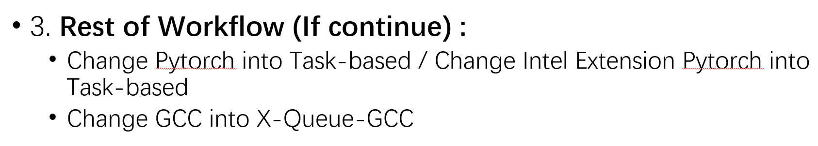
Next steps
Memory issue from NUMA -> X-Queue load balance may work
CPU-GPU computing
CPU for sth
GPU for Compute
Pie: Pooling CPU Memory for LLM Inference

Slide 26
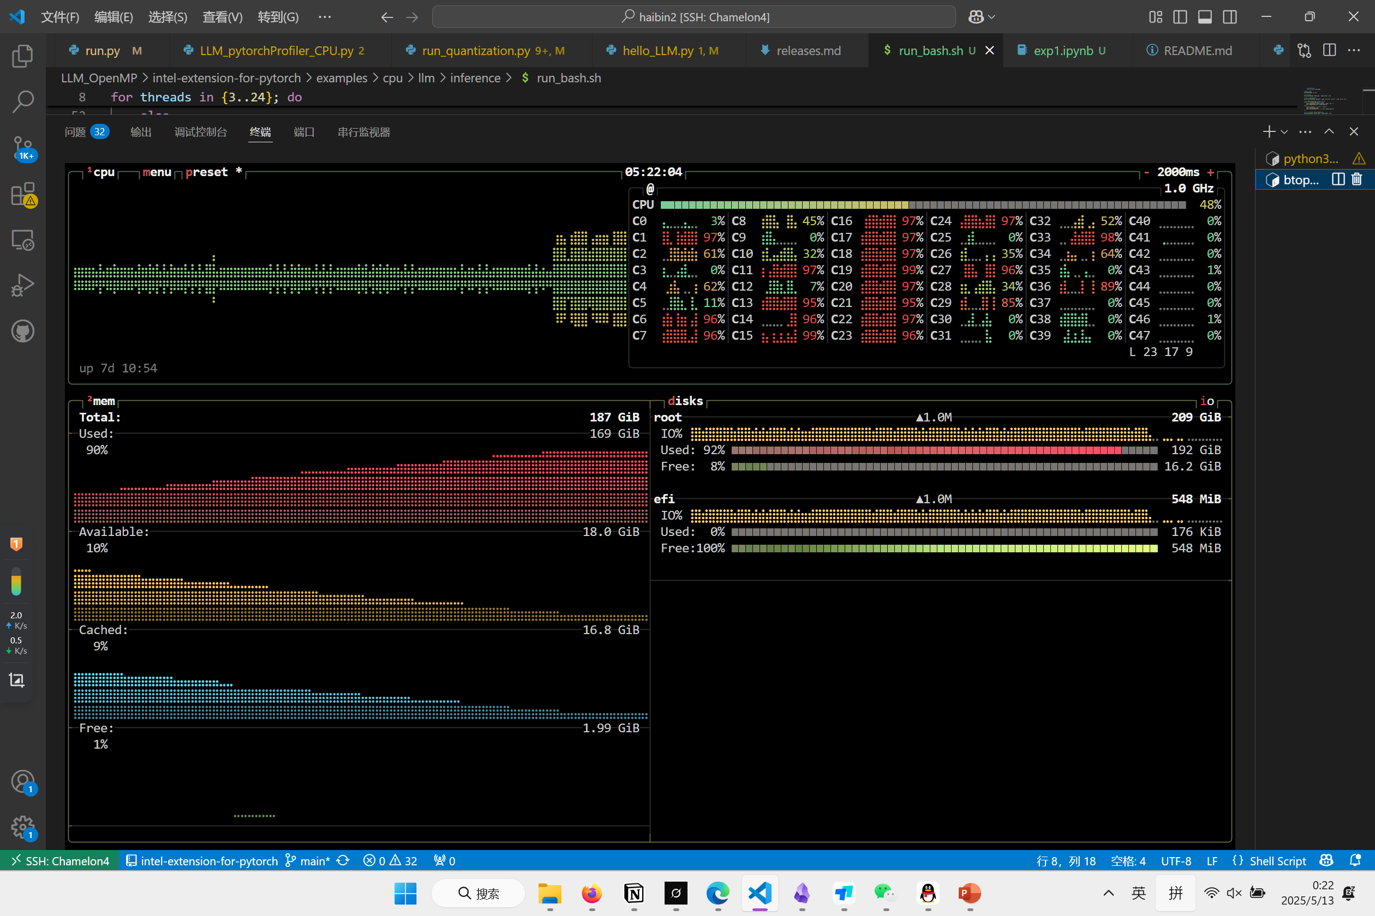
EOF
Iteration: 0, Time: 323.911800 sec

